Slide 1
Wednesday
9.30 – 10.30 Intro & Business Overview
10.45 – 11.30 Define your customer
11.30 – 1.00 Digital Fundamentals – Planning your website
1.00 – 1.30 Lunch
1.30 – 3.00 Set Up your platform, plugins and payments
3.15 - 4.15 Content that tells stories
Thursday
9.30 – 10.00 Check in
10.15 – 11.30 Connecting Google
11.30 - 12.15 Setting up a product/service page
12.15 – 1.00 Other Pages eg privacy, about us, terms and conditions
1.00 – 1.30 Lunch
1.30 – 2.30 Social content
2.45 – 3.45 Email set up
4pm LAUNCH!
Notes:
No changes.

Slide 2
Purpose Statement
My / Our purpose is...
Prompts
Why did you start your business?
What problem do you solve for your customers?
Why are you different to your competition?
Notes:
book

Slide 3
GOALS
I will achieve this by….
1
2
3

Slide 4
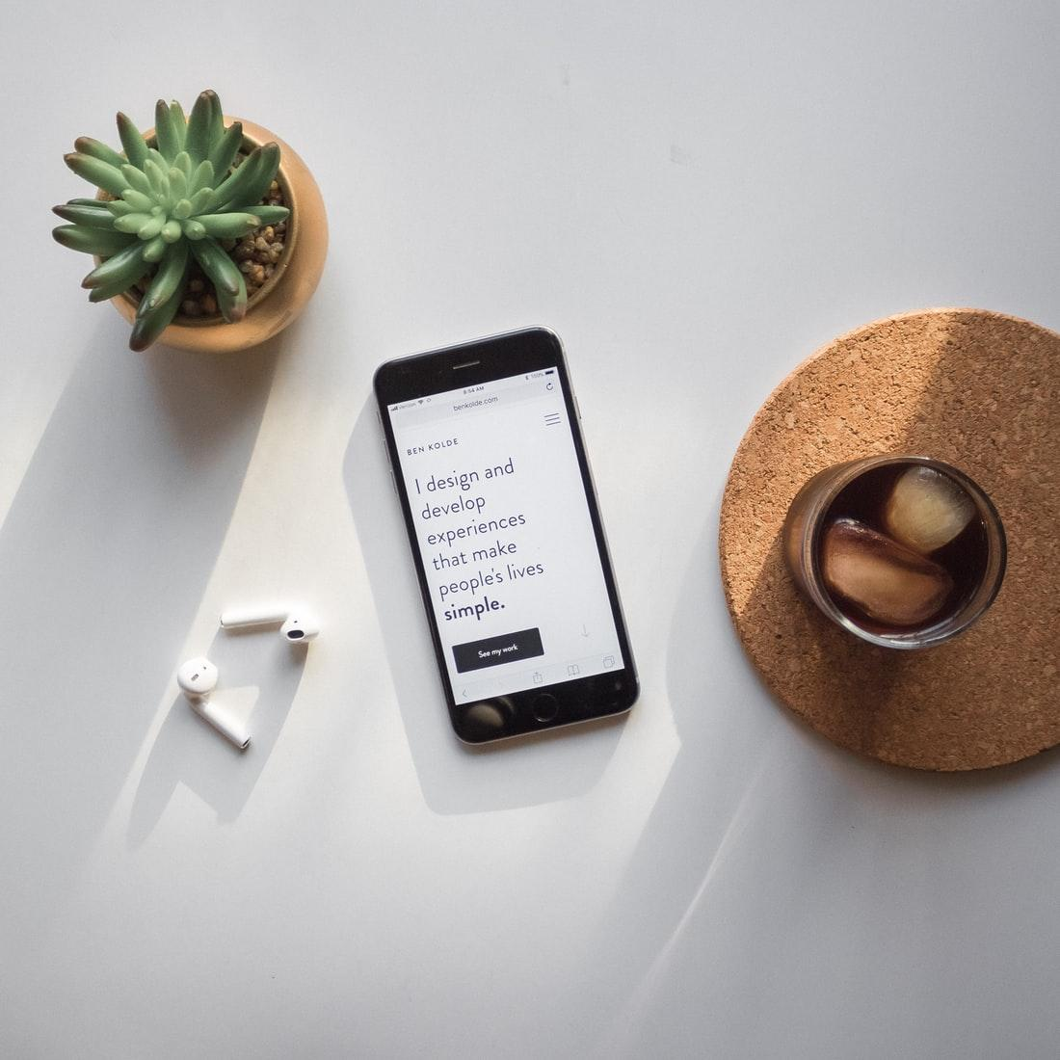
YOUR
CUSTOMER

Slide 5
EXAMPLE
“Work-life balance is difficult. Parenting is
even harder. I feel I have little time for myself.”
Rachel, 33
Chartered Accountant
Mother of 1
Randwick, Sydney
Rachel is a super mum who struggles to balance between family and career. She enjoys being busy but gets stressed when there is too much on her table. She’s ambitious on career development and sees that as the primary focus of her life. She cares a lot for her son and wishes she had more time with him.
Devices:
Surface Pro, iPhone XR, Apple Watch
Social Media:
Instagram, Facebook, LinkedIn
Go-To Brands & Stores:
Witchery, Country Road, Zara, SABA
Frustrations
Needs
Time poor - work-life balance
Difficult to be a parent
Hasn’t fulfilled career ambitions
Fatigue / stress
Little time to sit back and relax
Limited browsing options (Recommendations)
Delivery to office and home
Career stimulant
Recommendations
Escapism

Slide 6
Your Customer
Describe them…..
Prompts
Age?, Location?, Lifestyle?, Frustration?, Needs?
Notes:
book

Slide 7
“WHAT I SAY”
Rachel, 33
“I needed a new dress for a wedding”
“I was looking for a new wardrobe for work”
“Best jeans for fat thighs”
“I want a date night outfit”
“What to wear for a barbeque”

Slide 8
Statements
What do they say…..
1.
2.
3.
4.
5.
Notes:
book

Slide 9
Keywords
Volume
Competitiveness
1
2
3
4
5
6
7
8
9
10
3 STEPS TO 10 KEYWORDS TM

Slide 10
Competitors
Name:
Do well
Improve

Slide 11
PLATFORM PLANNING

Slide 12
Website Review: Home Page
Product/Service Page | Notes | Score | Action
Hero Image | Can you see below the fold? Is it clear what you do? | /10
Menu | Is the menu intuitive? Can I easily find what I need? | /10
Call to Action | Are there clear call to actions? | /10
Customer Focus | Are you addressing their problem? Are you talking in their language? Does the content reflect your customer and their needs? | /10
Story | Can they clearly see why you? | /10

Slide 13
Website Review: Product/Service Page
Product/Service Page | Notes | Score | Action
Product/Service Images | 4 - 5 Images for optimal conversion? | /10
CTA | Is the add to cart or book button above the fold? | /10
Social Proof | Is their social proof or validation? | /10
Shipping/Delivery information | Are your fulfillment steps clear? | /10
Contact | Can I get help? | /10

Slide 14
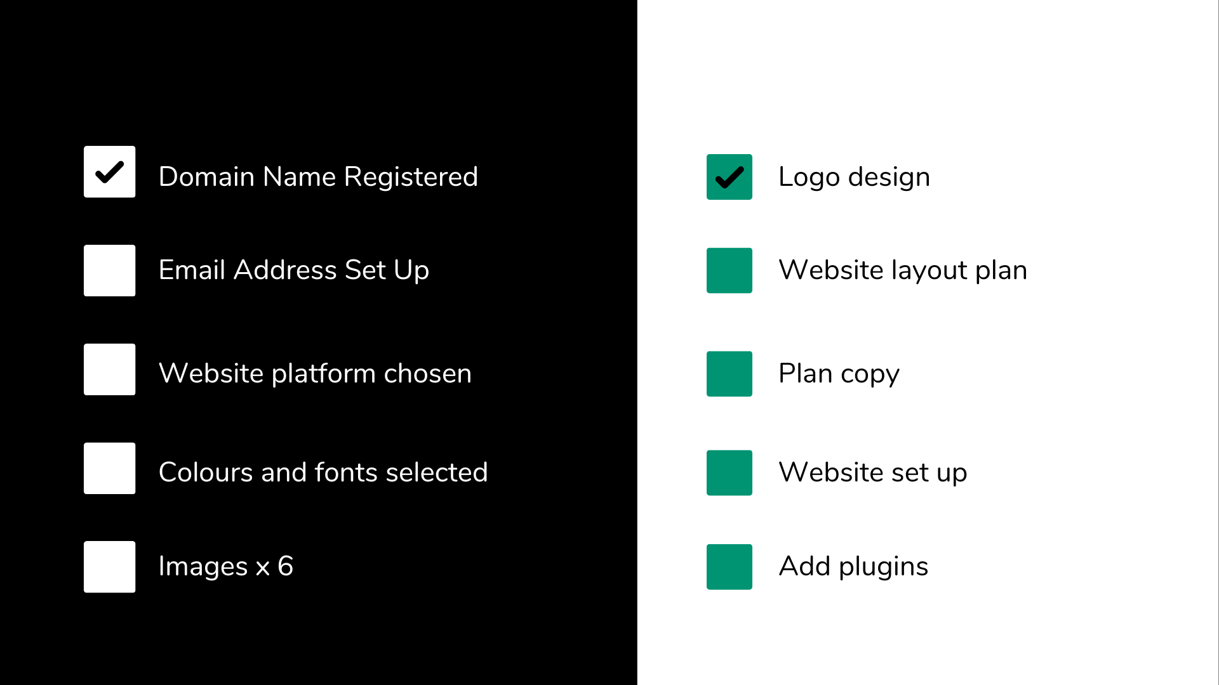
Website Checklist
Checklist
Google Search Console
Google My Business
Google Analytics

Slide 15
CONTENT
STORY TELLING

Slide 16
Your Story
Once upon a time there was…..
The villain …..
In the end…..

Slide 17
Email: kelly@kellyslessor.com
Mobile: 0404 823976
KELLY SLESSOR

